Slide 1


IT4043E
Big Data
Storage & Processing
GROUP
4
TAXI TRIP ANALYSIS SYSTEM FOR NYC TLC YELLOW TAXI RECORDS

Slide 2



Completed Work
Implemented Components & Simulations

Slide 3





Project Progress So Far
Data Source
Real-time Streaming
Serving Layer

Slide 4
Project Progress So Far
1. Core System Infrastructure Setup
Containerized the development environment using Docker.
Configured local services to run and communicate within the Docker-based environment.
2. Data Pipeline Prototype Development
Built a minimal end-to-end working prototype of the pipeline.
Kafka: Implemented producer and consumer to simulate streaming data flow.
Spark: Conducted initial transformations to validate batch/stream processing logic.
Cassandra: Designed and tested a basic schema for storing processed records.
3. Monitoring & Visualization Setup
Created an initial Grafana dashboard to visualize pipeline metrics and output.
Integrated Grafana with the underlying data source for real-time updates.

Slide 5
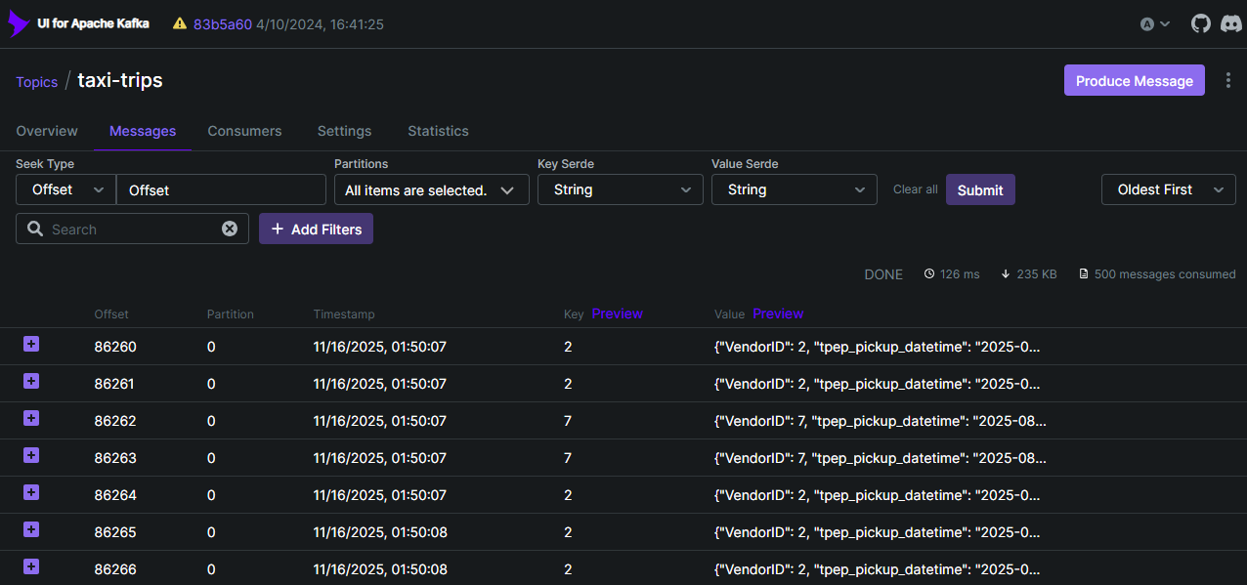
Demonstration of our Work

Slide 6
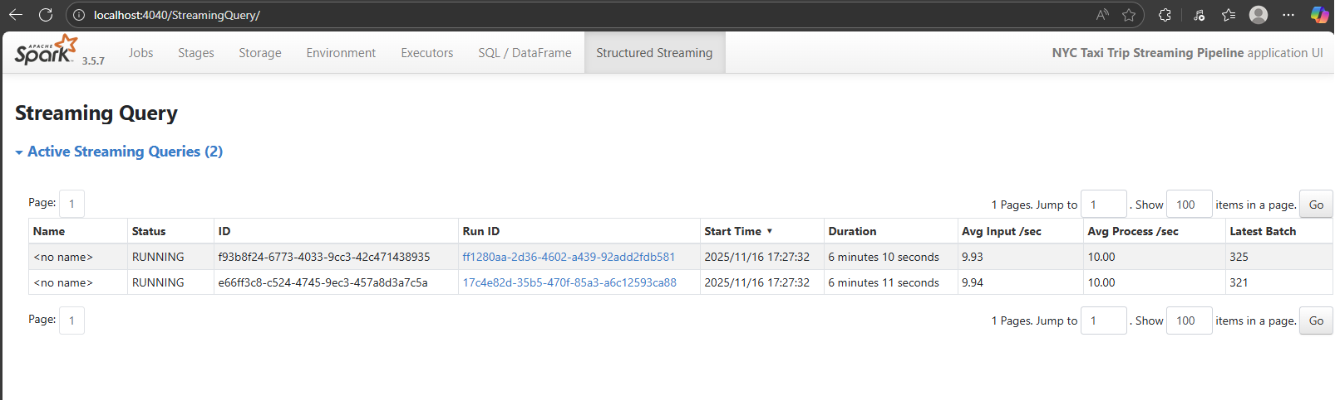
Demonstration of our Work

Slide 7
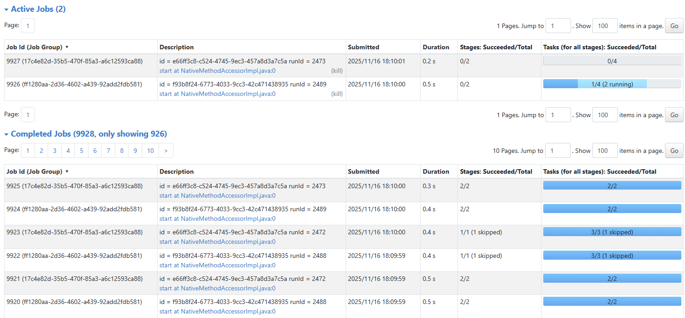
Demonstration of our Work

Slide 8
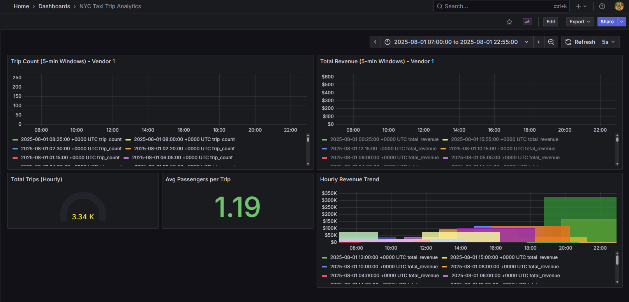
Demonstration of our Work

Slide 9
Problems To Be Solved
Proposing Practical Business Questions to be Solved

Slide 10
Proposing Practical Business Questions to be Solved
Business Question | Why It Matters | Data Needed | How We Will Answer It
What are the demand patterns (pickup counts, distances, passenger counts) across time and location? | Understand traffic peaks, identify high-demand zones, support resource allocation. | Pickup timestamps, zones, trip distance, passenger count. | Aggregate trips per time window + zone → store hourly/daily summaries in Cassandra → Grafana visualizes heatmaps, time-series, top-N zones.
Which zones, vendors, or hours contribute most to revenue and profitability? | Helps identify profitable operations, surge periods, and vendor performance. | Fare amount, extra fees, vendor ID, pickup/dropoff location/time. | Spark computes revenue per zone/vendor/time window → Cassandra stores aggregated revenue tables → Grafana plots top vendors, revenue trends, and zone profitability.
Are there operational inefficiencies or anomalies (e.g., unusually long trips, delays, abnormal behaviors)? | Detects potential issues such as routing problems, driver anomalies, or unusual spikes. | Trip duration, trip distance, timestamps, potentially speed-derived metrics. | Spark flags outliers via simple thresholds (e.g., long duration per mile) → Cassandra stores anomaly counts → Grafana shows alerts, anomaly timelines.

Slide 11
Future Work
Next Steps for our Project

Slide 12
Components Overview
1. Finalize Data Modeling & Integration
Define Cassandra table schemas aligned with business questions.
Implement Spark → Cassandra write pipelines (batch & streaming).
Validate schema correctness with small-scale test writes before full ingestion.
2. Expand Analytics & Aggregation Logic
Implement full aggregation workflows (revenue, demand patterns, anomalies).
Optimize Spark transformations for throughput and stability.
Add windowed aggregations and zone-level metrics based on final requirements.
3. Complete Dashboard & Visualization Integration
Connect Grafana to the finalized Cassandra datasource.
Build dynamic and drill-down dashboards for each business question.
Implement visual alerts (e.g., anomaly spikes, peak demand periods).

Slide 13

Demonstration
Showcasing our Minimum Prototype

Slide 14
Thank you!

